Slide 1


Dual Enrollment

Slide 2

Program Information
Simultaneous enrollment in high school and college courses
College courses will count towards your high school graduation requirements
Receive extra half point up to a 3.0 for Dual Enrollment courses toward their HOPE GPA
Can enroll at multiple institutions w/counselor approval
FREE for up to 30 credit hrs
OPTIONAL and recommended, not required

Slide 3

Cautions
Your professors will not know you are a dual enrollment student, so they will treat you like a college student
Your college GPA will follow you!
College and high school calendars do not always align
    Fall/Spring/Winter Break
    Extracurricular activities
    Attendance policies
Reach out to instructors first when there is an issue
Failing or withdrawing can affect your graduation status!

Slide 4
What is covered
  Tuition*
  Mandatory student fees
  Textbook rentals (lab manuals included)
    Physical
    OER – open resource
    Access Codes
*State funding will cover up to 30 credit hours of approved courses

Slide 5
What is not covered
  Parking passes
  Dining plan
  Course fees
  Housing
  Transportation

Slide 6
Who is eligible?
  Juniors and Seniors
    10th graders require 1200 SAT or 26 ACT
  3.0 unweighted HOPE GPA
    EGSC evaluates only courses that are considered part of the USG recognized 17 Required High School Credits
    Overall GPA is insufficient (Band, ROTC, PE, etc.)
  Be on track to complete Required High School Curriculum
  Test scores not required but recommended

Slide 7
Application Process
  Meet with your hs counselor to see if you are eligible based on your HOPE gpa, ACT, SAT, etc.
  Apply to the college
  Send transcripts/test scores
  Complete funding application for dual enrollment
  Get registered
    HS counselor or student can schedule with the dual enrollment counselor at the college

Slide 8
Placement
  Students must meet the following course criteria:
    English: Two units of RHSC English must be successfully completed prior to the start of the Dual Enrollment term; and,
      Eligible for English, History, Sociology, Government, etc.
    Math: High school Algebra II or the equivalent must be successfully completed prior to the start of the Dual Enrollment term.
      Math course placement is based on GPA and standardized test scores.
        3.2 for College Algebra
  Test scores are no longer required
  Students who have taken PSAT, SAT, PreACT, ACT, or Accuplacer can submit scores to assist in additional course placement

Slide 9
Funding
Limitations
  30 credit hour cap
  2 withdrawals, no repeated courses
  Only approved courses
Go to GAFutures to see the full course directory!

Slide 10
Obtain Funding
3 step process:
You and your parent/guardian must complete the GAFutures Funding Application/Participation Agreement
You will need to have met with your high school counselor first to go over what classes you will be approved to take as a dual enrollment student
Your high school counselor must complete their part of the GAFutures Participation Agreement and courses(s) to be taken

Slide 11
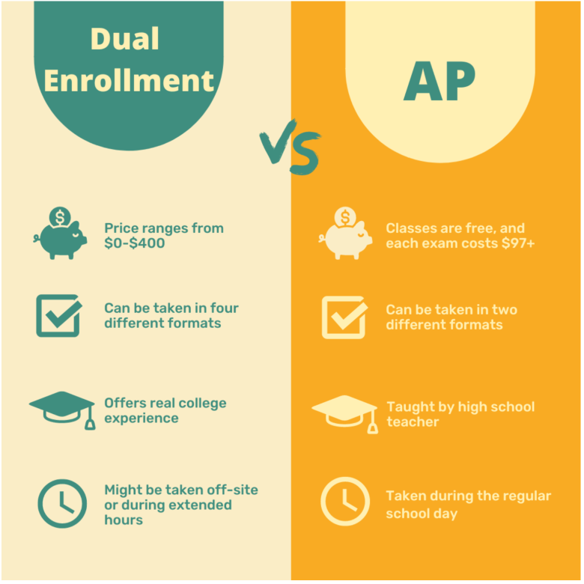
AP vs Dual Enrollment
AP is recognized nationwide.
Students must take and pass AP exam to receive college credit.
Students must pay for AP exam (some free test options available).
Students with the highest ACT and SAT scores tend to take the most AP classes.
Which is more important, getting ahead or being prepared?

Slide 12
Contact Information
Morgan Clifton
Dual Enrollment Coordinator
morgan_clifton@ega.edu
478-289-2022
Jennifer Fields
Director of Admissions
jfields@ega.edu
478-289-2129

