Slide 1


Slide 2
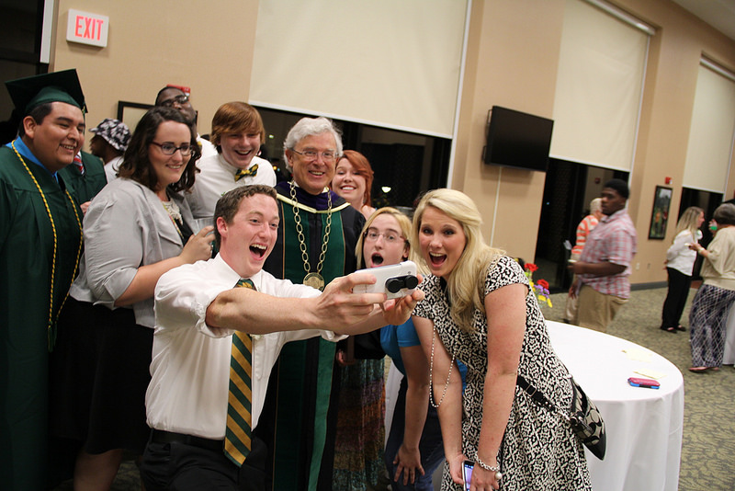
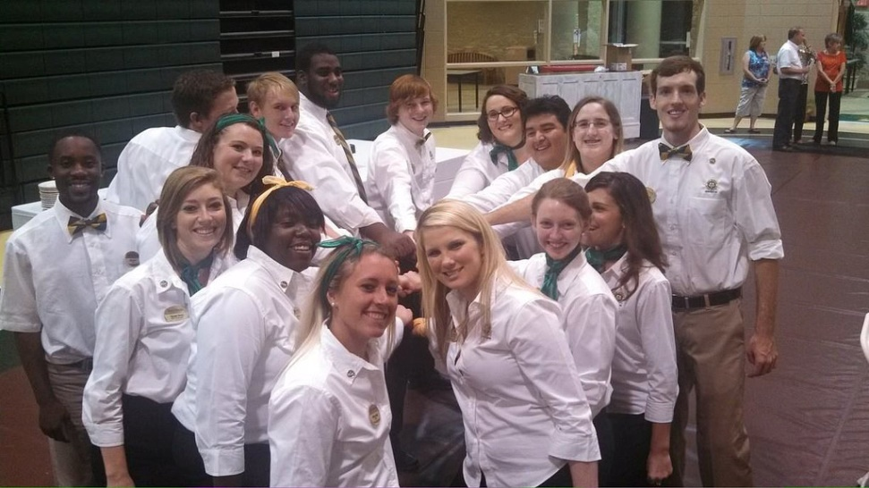
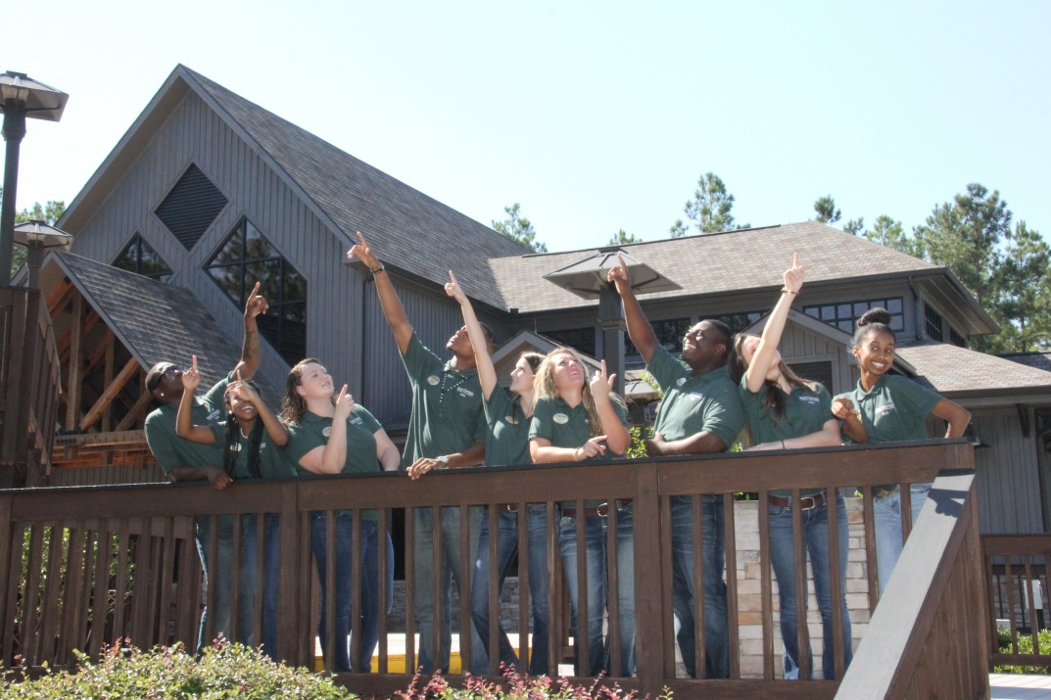

It’s a Great Place for Students in Our Great Community to Start

Slide 3
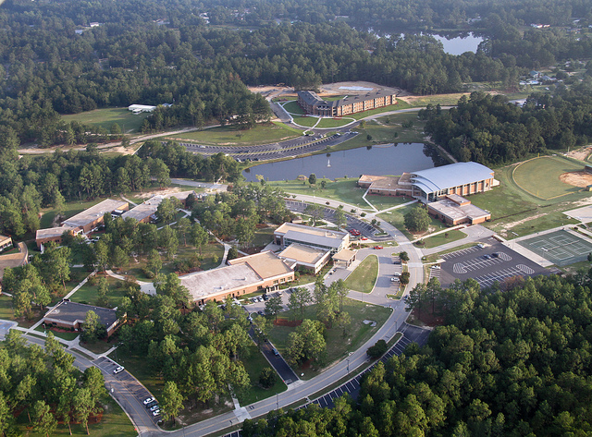

Slide 4
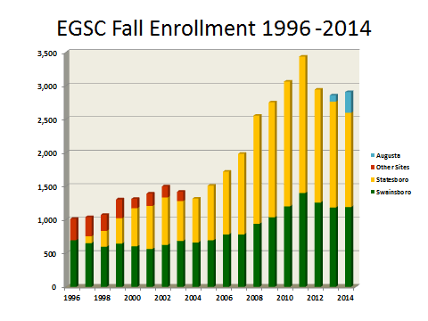
Growing at 3 Locations to Meet Student Needs

Slide 5

Are You Concerned About this Trend in the U.S.?
$1.2 TRILLION DOLLARS OF STUDENT LOAN DEBT IN THE U.S.

Slide 6
East Georgia State College
It’s a Smart Financial Decision
Lowest Total Cost in University System of Georgia
(Per Semester) 2014-2015
INSTITUTION | TUITION (15 hours) | FEES | HOUSING (Example)* | MEAL PLAN (Example)* | TOTAL
Research University (Georgia State University) | $4,056 | $1,064 | $4,016 | $1,762 | $10,898
Comprehensive University (Valdosta State University) | $2,549 | $1,032 | $2,462 | $1,896 | $7,939
State University (Columbus State University) | $2,549 | $900 | $2,725 | $1,248 | $7,422
State College (Middle GA State College) | $1,495 | $541 | $2,675 | $1,393 | $6,104
State College (East Georgia State College) | $1,330 | $443 | $2,730 | $1,041 | $5,544
* Colleges offer options. This is an example of one typical option at each institution.

Slide 7
East Georgia State College
It’s a Smart Financial Decision
Lowest Total Cost in University System of Georgia
(Per Semester) 2014-2015
INSTITUTION | TUITION (15 hours) | FEES | HOUSING (Example)* | MEAL PLAN (Example)* | TOTAL
Research University (Georgia State University) | $4,056 | $1,064 | $4,016 | $1,762 | $10,898
Comprehensive University (Valdosta State University) | $2,549 | $1,032 | $2,462 | $1,896 | $7,939
State University (Columbus State University) | $2,549 | $900 | $2,725 | $1,248 | $7,422
State College (Middle GA State College) | $1,495 | $541 | $2,675 | $1,393 | $6,104
State College (East Georgia State College) | $1,330 | $443 | $2,730 | $1,041 | $5,544
HOPE will pay $77 per credit hour ($1,155 for 15 hrs) to students that graduate from high school as a HOPE Scholar, maintaining a 3.0 HOPE curriculum G.P.A. However, a student may gain HOPE after entering college and completing 30 semester credit hours and maintaining a 3.0 G.P.A.
* Colleges offer options. This is an example of one typical option at each institution.

Slide 8
East Georgia State College
It’s a Smart Financial Decision
Lowest Total Cost in University System of Georgia
(Per Semester) 2014-2015
INSTITUTION | TUITION (15 hours) | FEES | HOUSING (Example)* | MEAL PLAN (Example)* | TOTAL
Research University (Georgia State University) | $4,056 | $1,064 | $4,016 | $1,762 | $10,898
Comprehensive University (Valdosta State University) | $2,549 | $1,032 | $2,462 | $1,896 | $7,939
State University (Columbus State University) | $2,549 | $900 | $2,725 | $1,248 | $7,422
State College (Middle GA State College) | $1,495 | $541 | $2,675 | $1,393 | $6,104
State College (East Georgia State College) | $1,330 | $443 | $2,730 | $1,041 | $5,544
Federal Student Loans: Up to $5,250 per semester may be paid by Federal student loans and Federal parent loans if a student meets federal requirements.
* Colleges offer options. This is an example of one typical option at each institution.

Slide 9
East Georgia State College
It’s a Smart Financial Decision
Lowest Total Cost in University System of Georgia
(Per Semester) 2014-2015
INSTITUTION | TUITION (15 hours) | FEES | HOUSING (Example)* | MEAL PLAN (Example)* | TOTAL
Research University (Georgia State University) | $4,056 | $1,064 | $4,016 | $1,762 | $10,898
Comprehensive University (Valdosta State University) | $2,549 | $1,032 | $2,462 | $1,896 | $7,939
State University (Columbus State University) | $2,549 | $900 | $2,725 | $1,248 | $7,422
State College (Middle GA State College) | $1,495 | $541 | $2,675 | $1,393 | $6,104
State College (East Georgia State College) | $1,330 | $443 | $2,730 | $1,041 | $5,544
PELL: A student may receive up to $5,730 annually from the PELL grant, if eligible.
* Colleges offer options. This is an example of one typical option at each institution.

Slide 10
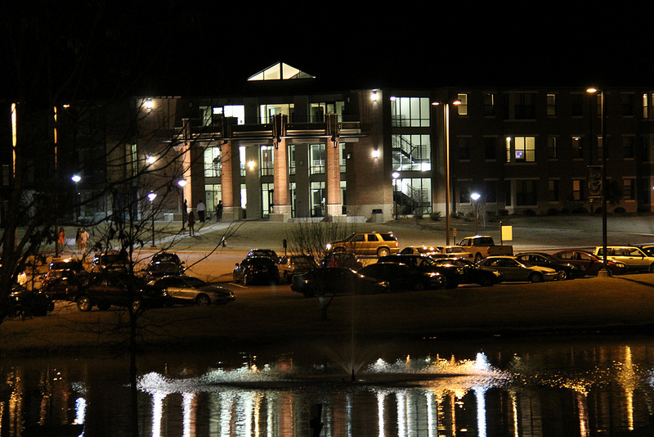
Bobcat Villas

Slide 11


Students of Excellence Striving to Make Transformational Contributions to Society
Program
OVERVIEW
$5,000 renewable scholarships for 20 students attending the Swainsboro Campus beginning Fall Semester 2015
Established to recognize and prepare exceptionally promising students as future community leaders in our region
Ideal candidates will demonstrate exceptional strength in leadership and service, balanced by academics; No minimum GPA or test score requirement
Application and Essay Deadline: February 1st, 2015 www.ega.edu/correll
Essay Topic: “How I Will Use a College Education to Transform Myself and My Community” (1000-word Max.)
Candidates will be announced in early Spring following interviews

Slide 12

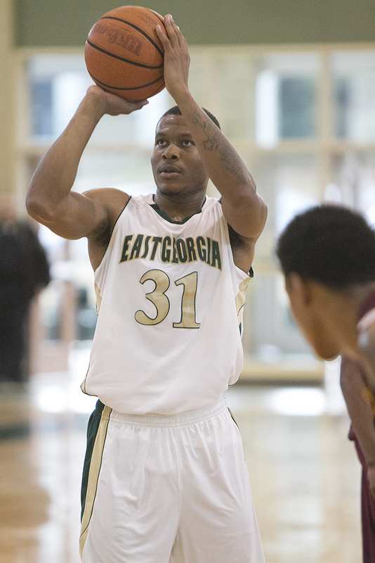
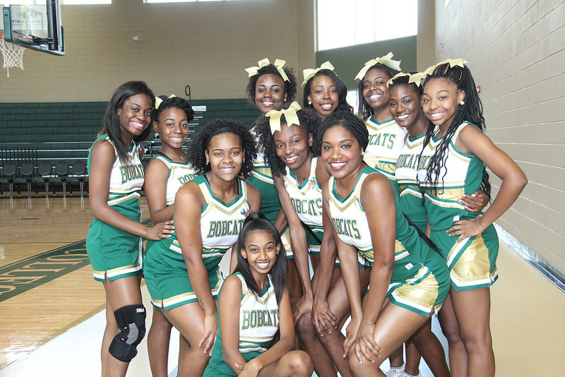



East Georgia State College
Athletics
Women’s
Basketball
Go Bobcats!
Men’s Basketball
Baseball
Women’s
Softball

Slide 13
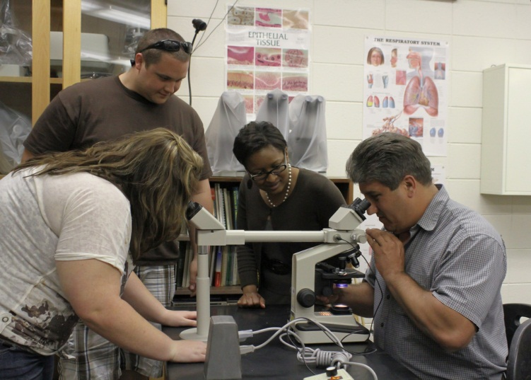
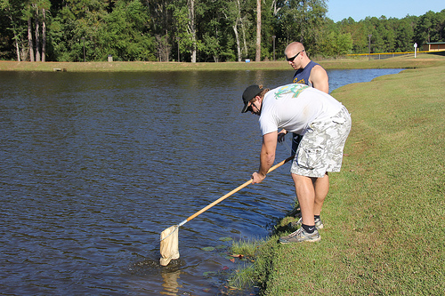
Bachelor of Science in Biology
Emphasis on a broad spectrum of study from the molecular level to the whole organism, as well as genetics, development, evolution and interaction with a dynamic environment.
The program provides in-depth studies and opportunities for research and internships that prepare students for medicine, dentistry, pharmacy, veterinary medicine, medically-related research, graduate and professional studies, and the business and industry work force.
Three graduates of the program

Slide 14
Coming in Fall 2015
Bachelors Degree in Fire and Emergency Services Administration!

Slide 15
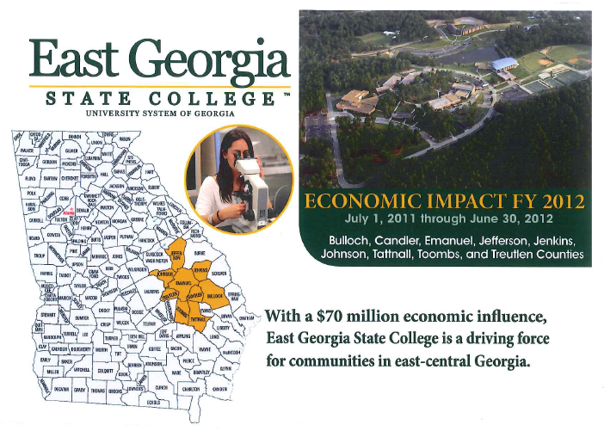

Slide 16
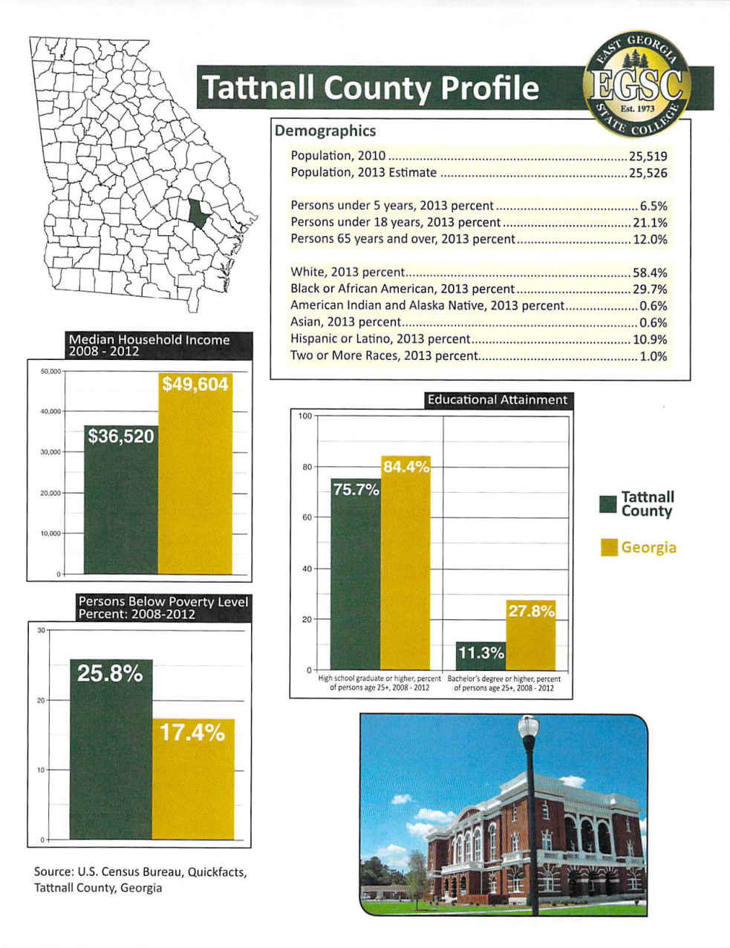
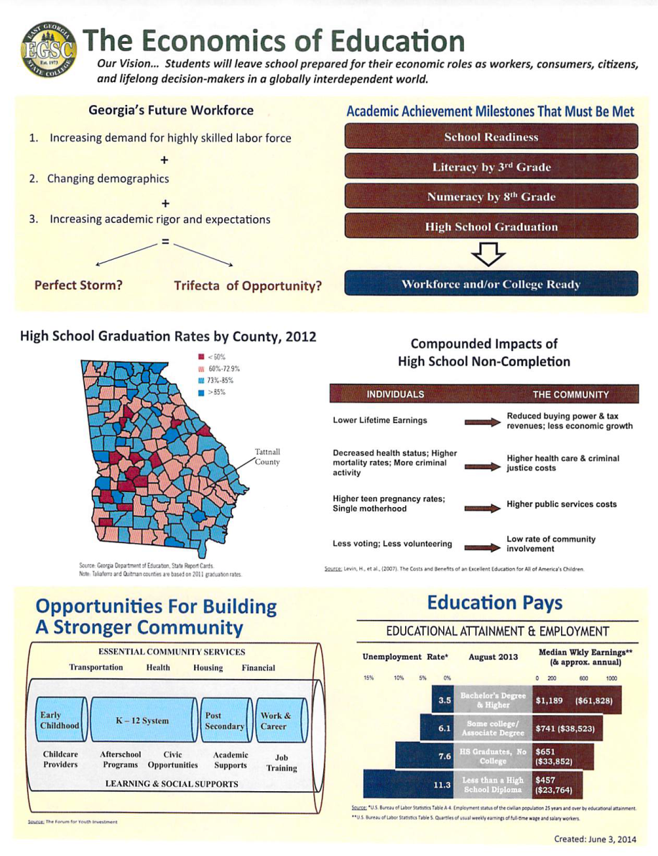

Slide 17

Please Join Us This Weekend!

Slide 18
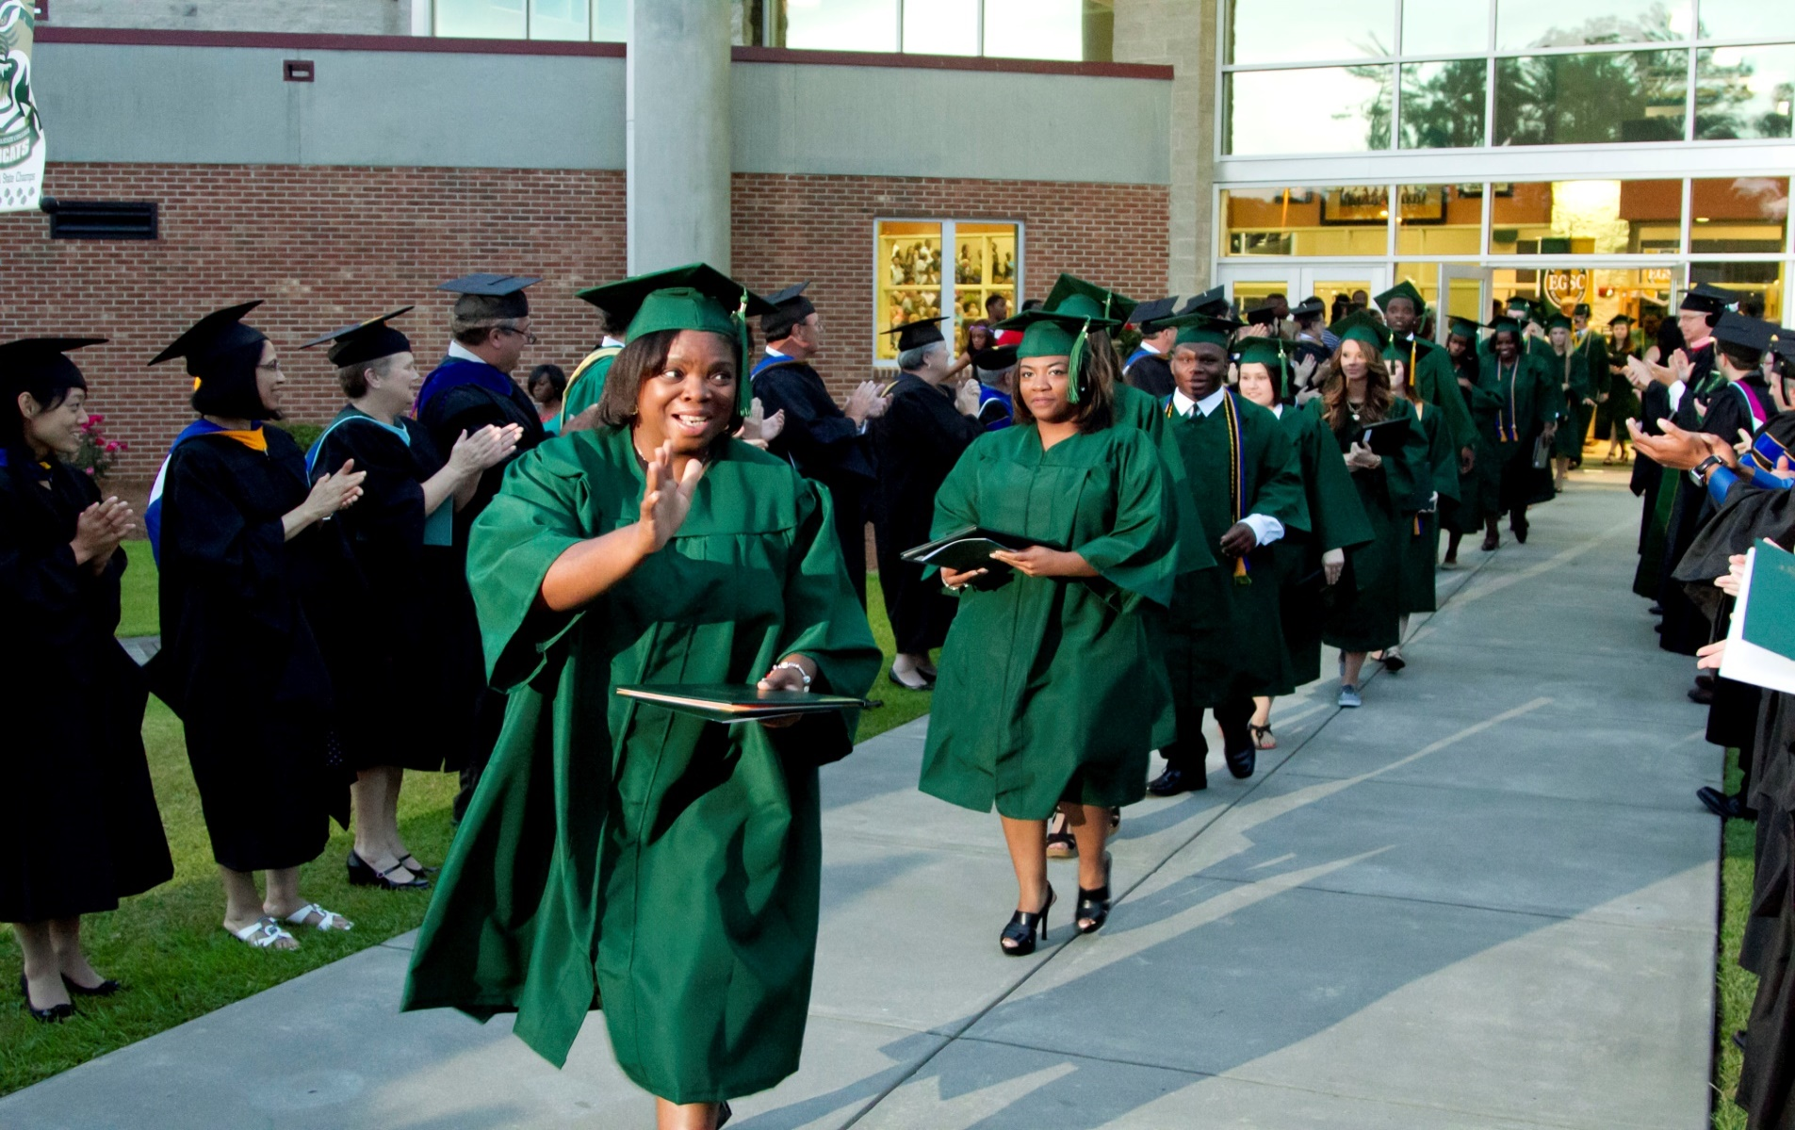
This is Our Vision for Students from Our Great Community

Slide 19
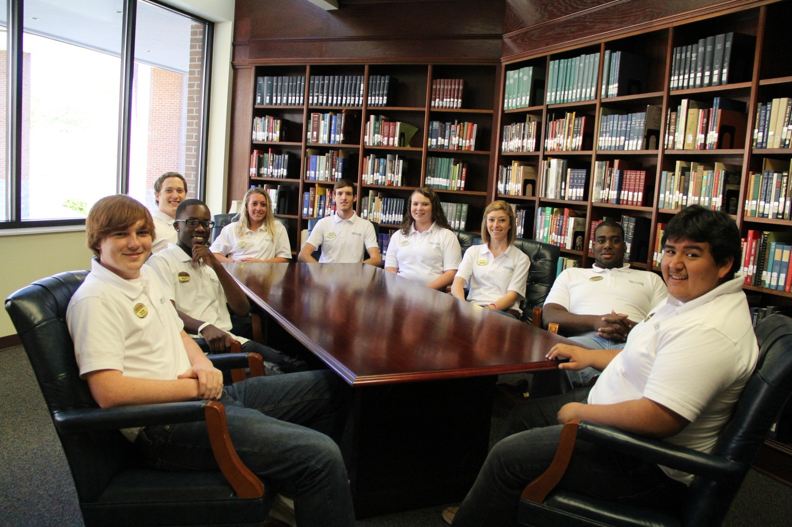
Thank you
BE BOLD.
GO GREEN AND GOLD

